Slide 1
React JS
Notes:
g

Slide 2
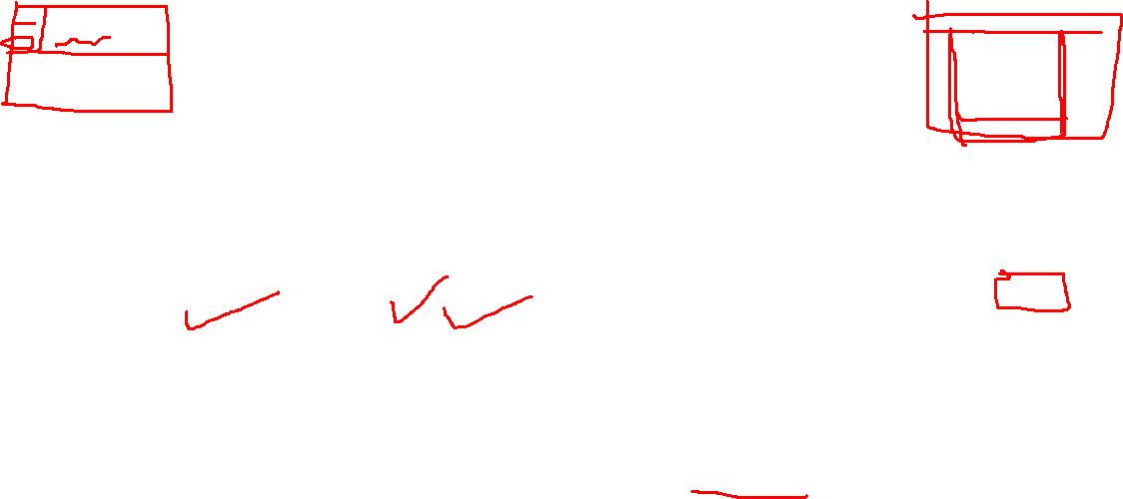
Introduction to React
■ ReactJS is a declarative, efficient, and flexible JavaScript library for building reusable UI components
■ It is an open-source, component-based front end library which is responsible only for the view layer of the application.
■ It was initially developed and maintained by Facebook and later used in its products like WhatsApp & Instagram

Slide 3
Why React?
■ The main objective of ReactJS is to develop User Interfaces (UI) that improves the speed of the apps
■ It uses virtual DOM (JavaScript object), which improves the performance of the app. The JavaScript virtual DOM is faster than the regular DOM
■ We can use ReactJS on the client and server-side as well as with other frameworks
■ Productivity

Slide 4
React Framework
■ JSX : JSX stands for JavaScript XML. It is a JavaScript syntax extension. Its an XML or HTML like syntax used by ReactJS.
■Components :ReactJS is all about components. ReactJS application is made up of multiple components, and each component has its own logic and controls.
■ One-way Data Binding :ReactJS is designed in such a manner that follows unidirectional data flow or one-way data binding.
■ Virtual DOM: A virtual DOM object is a representation of the original DOM object.
■ Simplicity

Slide 5
Pre-requisites ■ HTML5 fundamentals ■ CSS3 fundamentals ■ JavaScript Basics

Slide 6
React- Environment Setup

Slide 7
React Installation
To install React JS
Nodejs and Node Package Manager(npm)
To get started with React, you’ll need to have Node.js installed
https://nodejs.org/en/download/
React CLI(command Line Interface)
Command Line Interface – This is simply a tool set, which is used for creating, managing and building react applications quickly.
npm install –g create-react-app
npx create-react-app projectname(To create projects)
IDE for writing your code-Visual Studio
https://code.visualstudio.com/download#

Slide 8
React Installation
To check installed versions
Nodejs-
node –v
Npm
npm –v

Slide 9
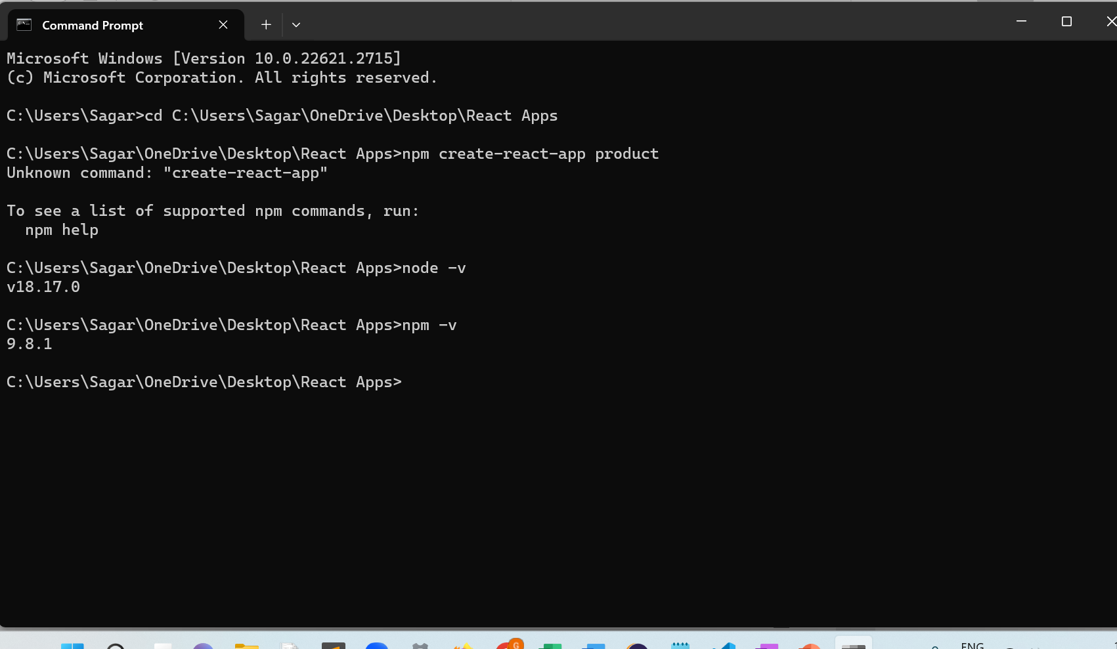

Slide 10
Essentials of React
Notes:
g

Slide 11
Components
The basic building blocks of the React framework are React components.
Components define views, which are sets of screen elements that React can choose among and modify according to your program logic and data
Components let you split the UI into independent, reusable pieces, and think about each piece in isolation. Conceptually, components are like JavaScript functions. They accept arbitrary inputs (called “props”) and return React elements describing what should appear on the screen. There are two types of components - Stateless Functional Components and Stateful Class Components

Slide 12
Functional Components
The simplest way to define a component is to write a JavaScript function. A valid React component because it accepts a single “props” (which stands for properties) object argument with data and returns a React element. We call such components “function components” because they are literally JavaScript functions

Slide 13
Class Components
Class components are more complex than functional components. It requires you to extend from React. Component and create a render function which returns a React element.
You can pass data from one class to other class components. You can create a class by defining a class that extends Component and has a render function.

Slide 14
Props
Props stand for "Properties." They are read-only components. It is an object which stores the value of attributes of a tag and work similar to the HTML attributes. It gives a way to pass data from one component to other components.
It is similar to function arguments. Props are passed to the component in the same way as arguments passed in a function.

Slide 15
State
The state is an updatable structure that is used to contain data or information about the component.
The state in a component can change over time. The change in state over time can happen as a response to user action or system event.
A component with the state is known as stateful components. It is the heart of the react component which determines the behavior of the component and how it will render.
They are also responsible for making a component dynamic and interactive.

Slide 16
Hooks
Hooks are the new feature introduced in the React 16.8 version. It allows you to use state and other React features without writing a class.
Hooks are the functions which "hook into" React state and lifecycle features from function components. It does not work inside classes.

